Slide 1

CodeMaster Academy.
ONLINE COURSE DASHBOARD: DESIGN THE STUDENT DASHBOARD FOR "CODEMASTER ACADEMY." SHOW ENROLLED COURSES AS CARDS, PROGRESS TRACKERS ( ELEMENT), UPCOMING DEADLINES, AND A SECTION FOR VIDEO LECTURES ( PLAYER WITH TRACKS).

Slide 2
LEVEL 2 Styled LAYOUT css

Slide 3

Dashboard Overview
Your Central Hub for Learning Success
Enrolled Courses
View all your courses as intuitive cards with visual progress trackers. Monitor completion percentages, access video lectures, and resume learning exactly where you left off.
Deadline Management
Stay on track with upcoming assignment deadlines and course milestones. Priority indicators and calendar views help you manage your learning schedule effectively.

Slide 4
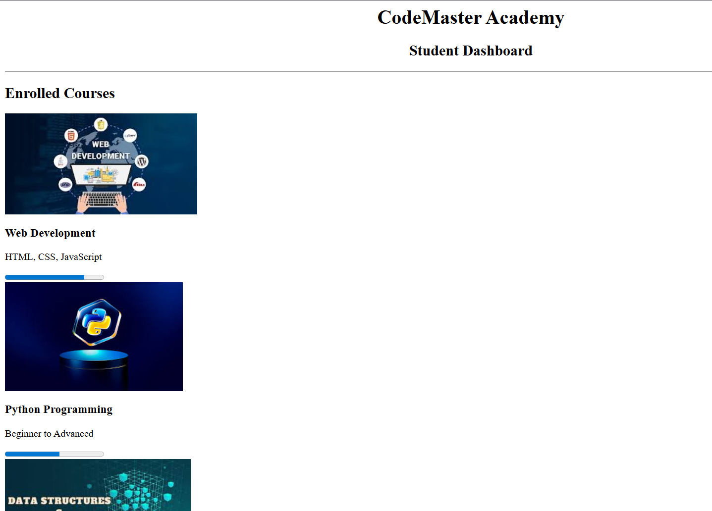
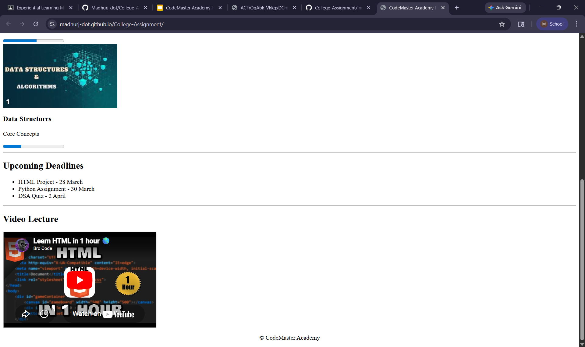
The Problem
Reason: No Styling

Slide 5
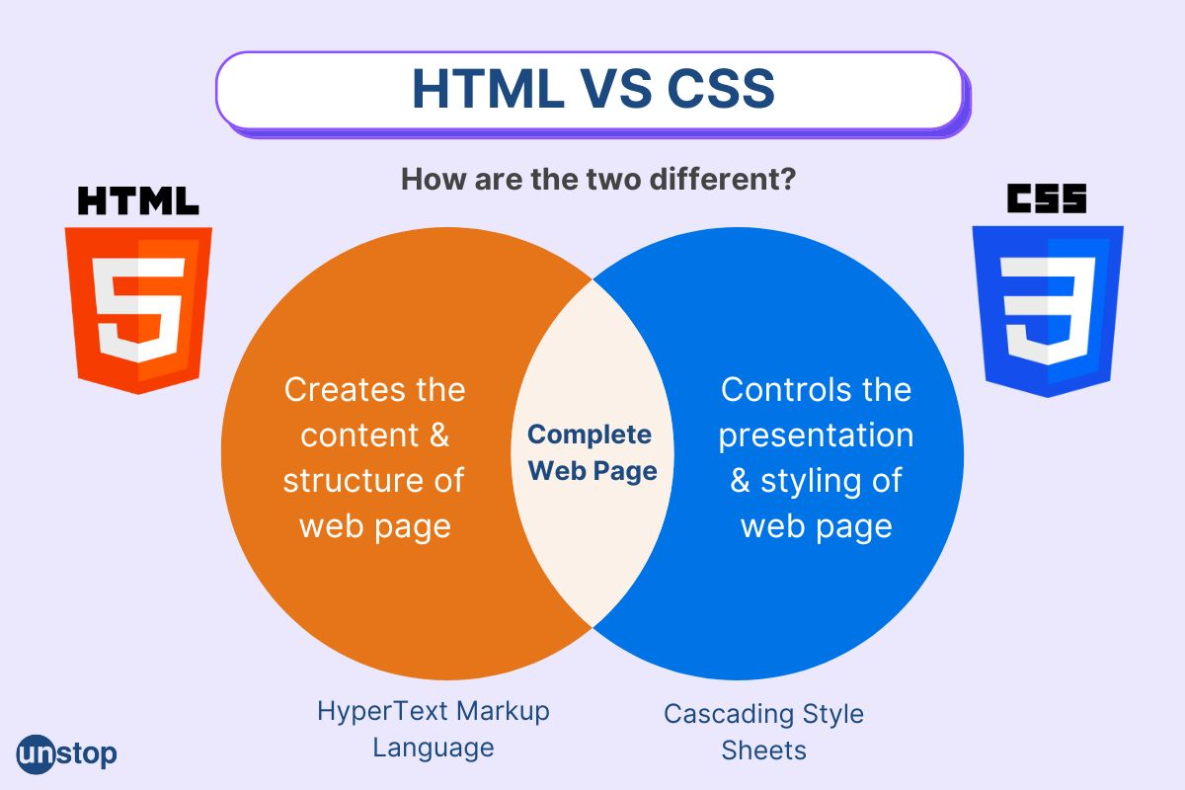
Dashboard Layout Structure
Structure: Uses Flexbox and Grid to align sidebars, widgets, and charts precisely.
Responsiveness: Ensures the layout adapts perfectly to both desktops and mobile screens.
Clarity: Uses spacing, colors, and fonts to create a visual hierarchy, making complex data easy to read at a glance.
Consistency: Allows you to style hundreds of data cards instantly using a single class.

Slide 6
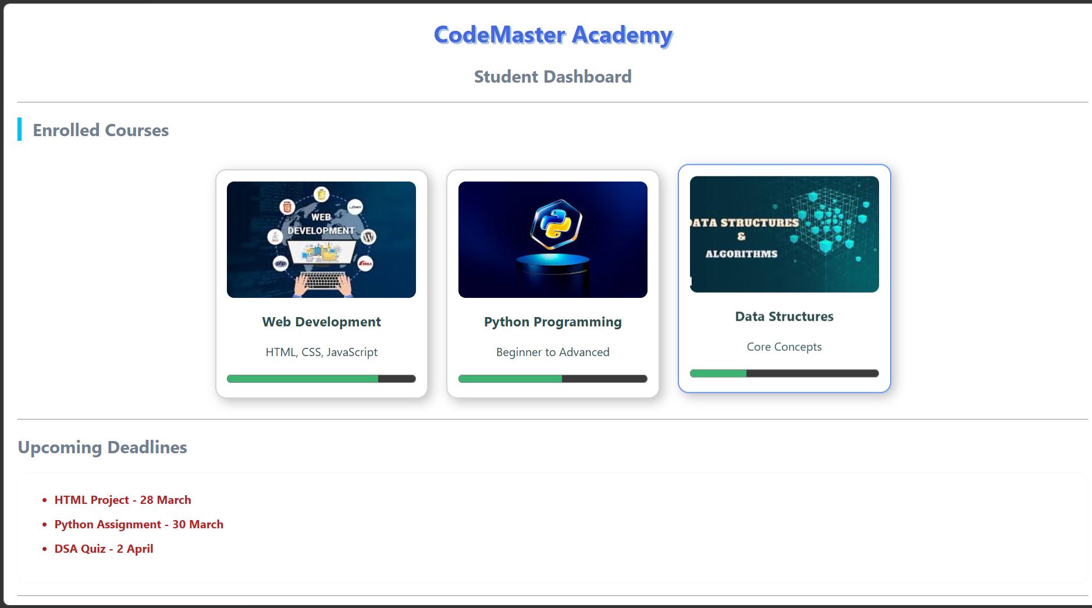
Solution: CSS

Slide 7
WELCOME TO CODEMASTER ACADEMY
Repository link: https://github.com/Madhurj-dot/College-Assignment.git
Live website link: https://madhurj-dot.github.io/College-Assignment/
Note:-
It’s Only add with CSS.

